Slide 1

Machine Learning: NBA Player Similarity Prediction
Team Members: Brandon Luy

Slide 2
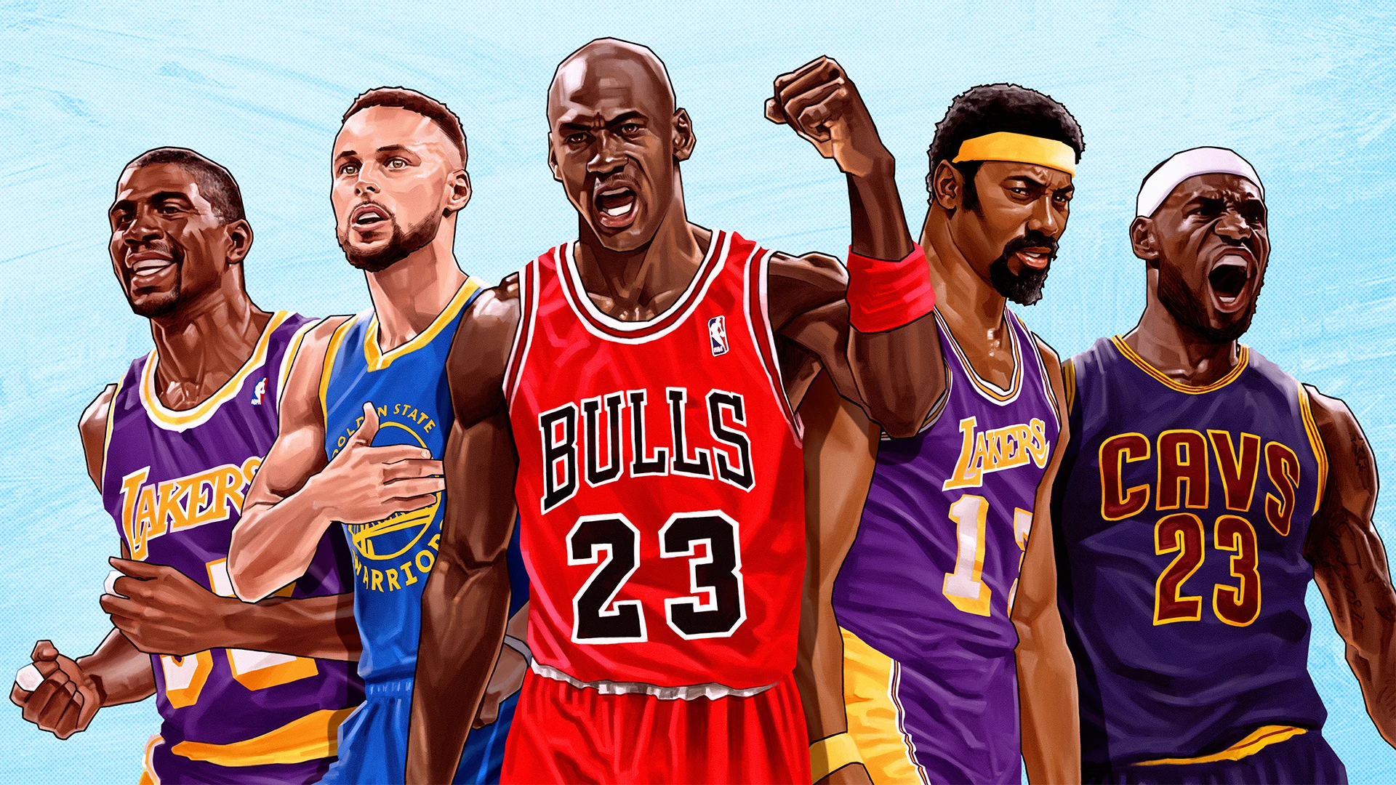


Introduction
Taking a Spin on Traditional NBA Predictors
Instead of predicting game outcomes compare and predict Player Similarity
Scalable to every player in the history of the NBA As long as they played when stats are recorded and played enough games (30) at end of season.

Slide 3

Motivation
Overall Sports Fan
More interesting to compare game styles of players compared to just train and predict
Notes:
the nba is one of most popular sports, stats are easy to track and distinguish 3pm, assists, rebounds
they allow shot charts, not many other sports track it so indepth (steph shooting from over 30+ feet)
compare the game styles of lebron vs stephen curry

Slide 4
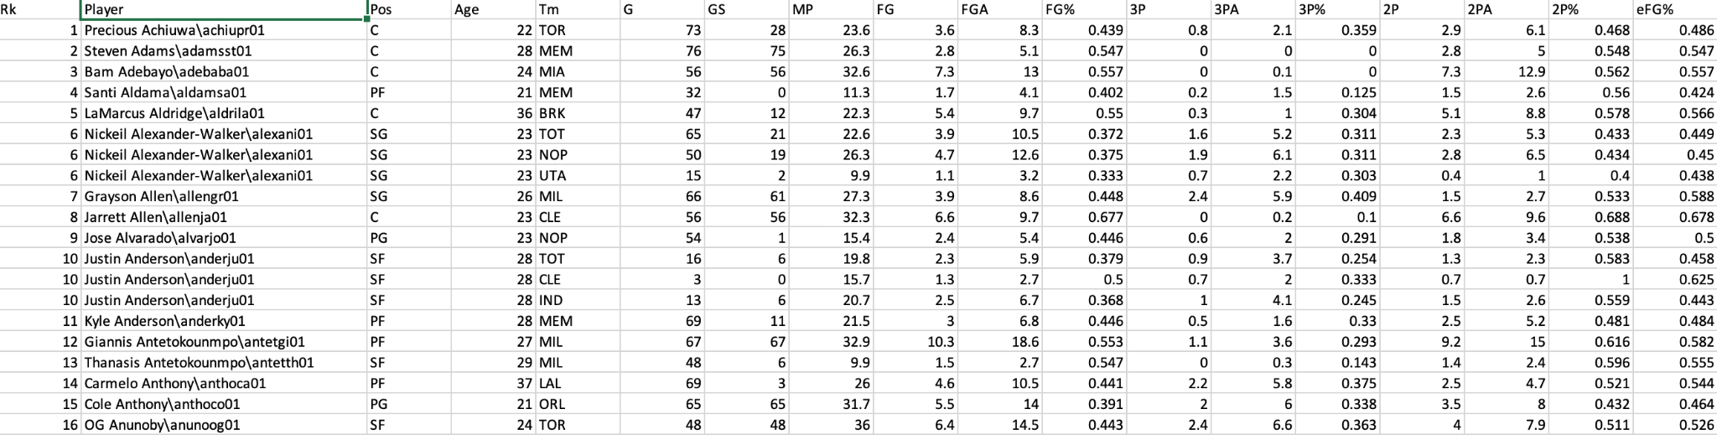
Dataset
The Data set used was the exported players stats from BasketballReference.com as a CSV
Notes:
dataset used for the project, 2021-2022 season as of right now,

Slide 5
Data Prep
The data initially came all in one column, so had to distribute into separate ones
Then had to clean each column that did not include players stats
Statistics that were not considered ‘Good Data’ were such as pass to assists, or fouls

Slide 6
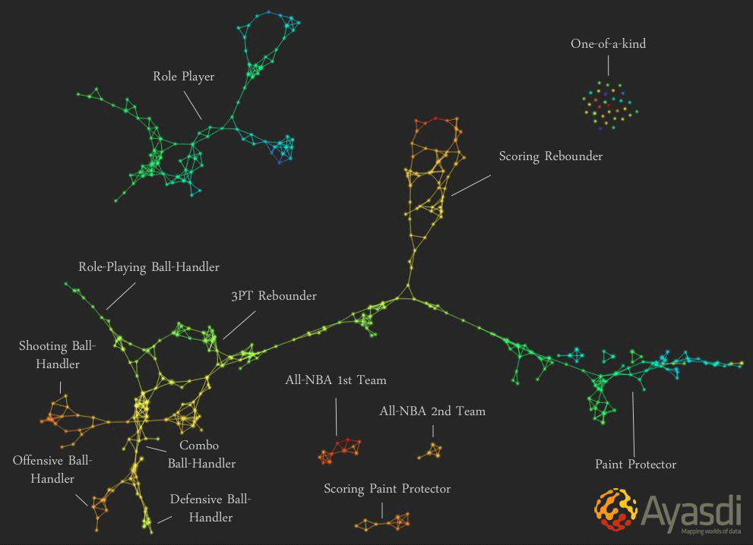
Methods
K-Means Set parameters pertaining to players stats and cluster players into groups.
Linear Regression Predict players stats using dataset, (input assists -> assists predicted to be average rest of season or total)
Mean Squared Error
Compare the predicted stats to the regression of the actual stat.

Slide 7
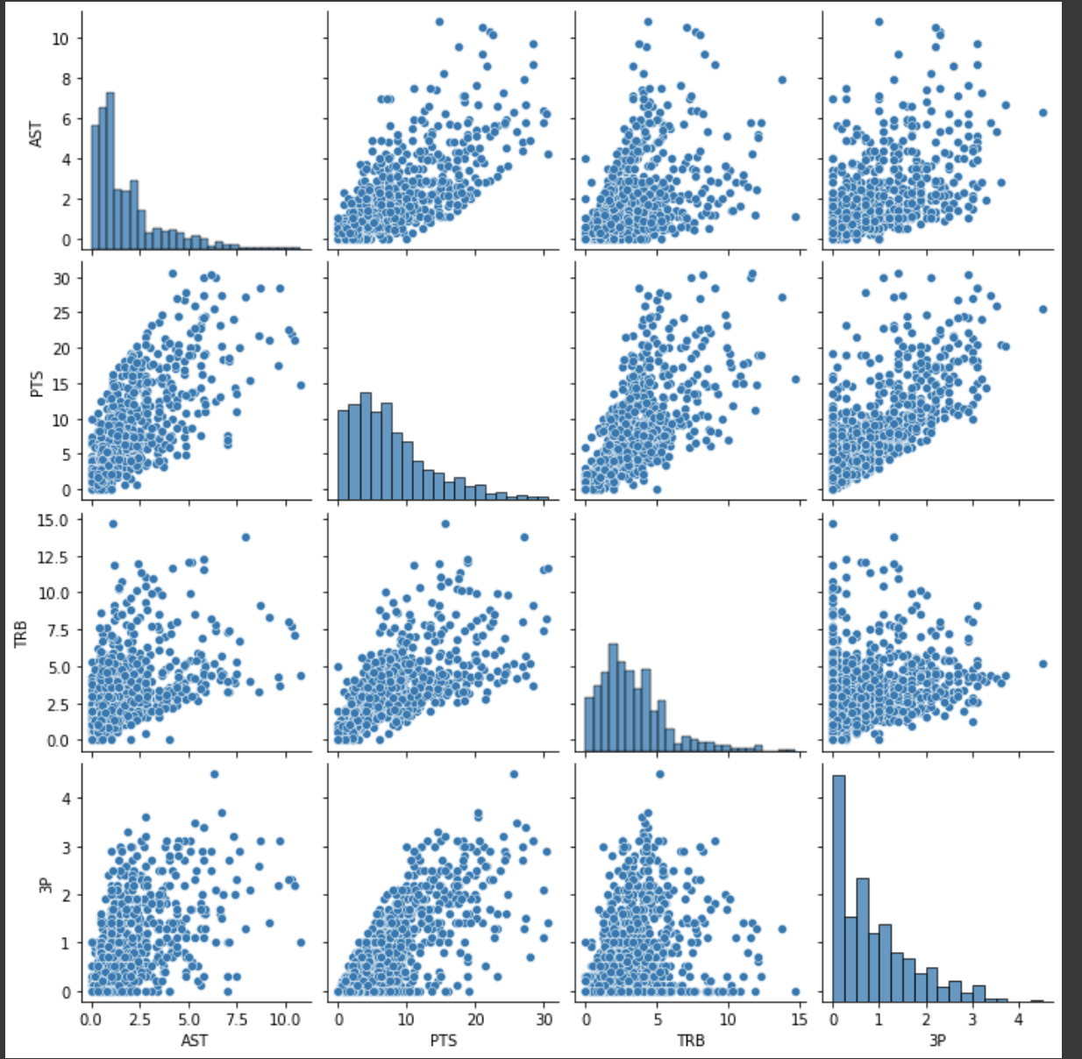
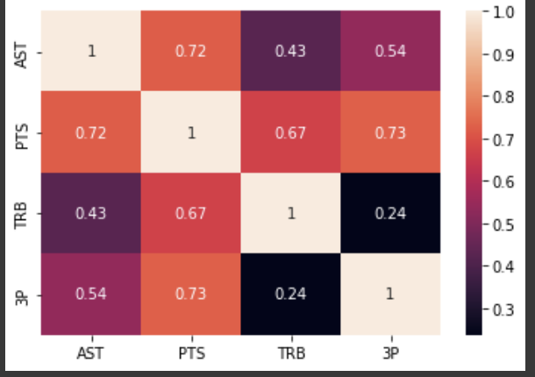
Analysis
Specifically with shots made and percentages of shots, you aren’t able to tell the percentage of the best players from a regular graph.
Employed the use of Heat Map to help visualize.
Notes:
NBA Shot Chart - shows shots made from where on court, how many shots taken from area and how many made, blue to red
heat map darker colors corellate with better production and efficiency

Slide 8

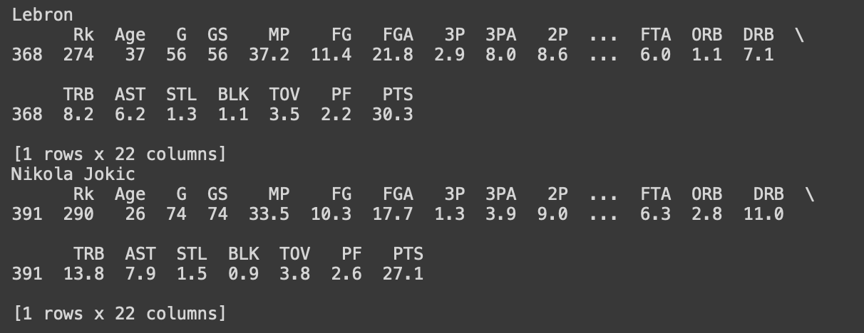
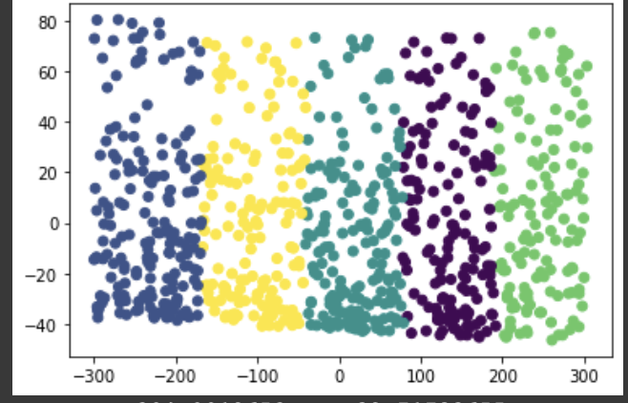
Results
Computed Linear Regression Confidence and Mean Squared Error
Lr-Confidence
0.4396253881855432 (Points, 3-Pointers, 2 pointers made, free throws made)
Mean Squared Error: 0.4531738876822222 (Same Stats)
Notes:
Results specifically from highest players in best cluster, their shot percentage, on the right is the cluster graph created to help visualize similar players
Trying to get to 1 for linear regression and 0 for mean squared error

Slide 9
Discussion of Findings
The model is better for certain stats than others, like production of players.
Players have to log a certain threshold of stats to be trained or considered ‘good data’.
The model had some skews pertaining to total shots made, compared to others.
Notes:
Production of players - points, field goals and 3 pointers attempted/made better than assists or total rebounds depends on position
Good data = at least 30 games, 10 minutes per game, if any of the columns were empty then the player would be counted as invalid (Klay Thompson, Malachi Flynn)
Some players play less than others, others more so if I created a baseline number of games maybe 55, then did the mean and calculations for those it would provide more accurate results. Because a player that played all 82 games would most likely have more shots made than a player that played 65, even though they average the same # of points

Slide 10
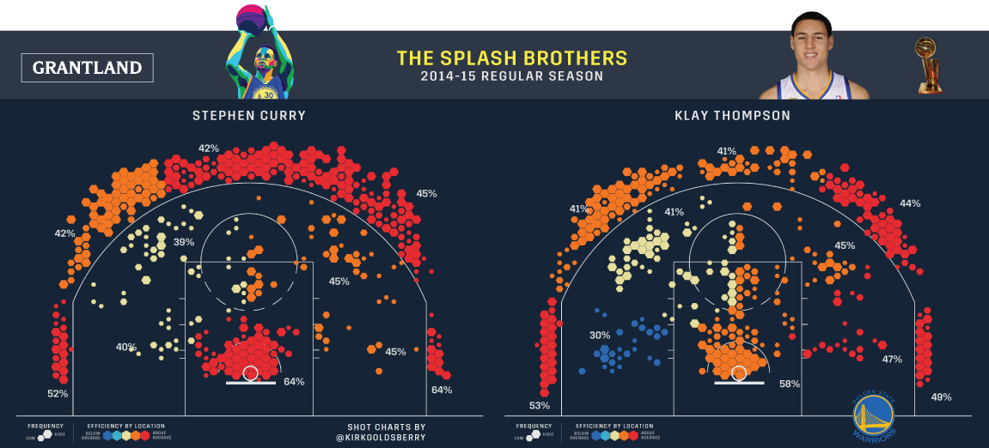
Next Steps
Revise the model to for a baseline of number of games
Add function to input stats, and it can work backwards to guess the player.
Notes:
Since some players play more games in a season

